Slide 1

Team C Algorithms Project
CS 51510- 002 Algorithms

Slide 2
Team Members
Sunilkumar Kalagarla
Sri Durga Latha Kalavakolanu
Samhitha Kasim
Sirish Chejerla
Shoaib Mohammed
Sriram Samineni
Sai Nitish Vemuri
Shalini Kandlamadugu Madanmohan
Sree Sai Adusumilli
Vijaya Abhigna Chiluka
Vakulasri Vagdhevi Bhima
Sumana Nalubola
Sarayu Kethidi
Sai Sravya Gadde
Suraj Reddy Annepally
Sumanth reddy Bontha
Saikiran Redy Mittapally
Sai Lokesh Sanisetty

Slide 3
Introduction
The course project aims to visualize and construct algorithms considering all the necessary factors necessary for people to travel.
The dataset was obtained through the exploration of various APIs and extensive investigation into methodologies for data extraction and organization.
Selecting an appropriate data structure for each specific milestone requirement by considering various factors such as the nature of the data, the operations to be performed, and the efficiency needed.
In- depth analysis and comparison of various algorithms to select the ones that yield most optimized outcomes.
Crafting unique visualizations by incorporating an unique mix of concepts and approaches for presenting the results.
Milestones
Milestone 1
Milestone 2
Milestone 3

Slide 4
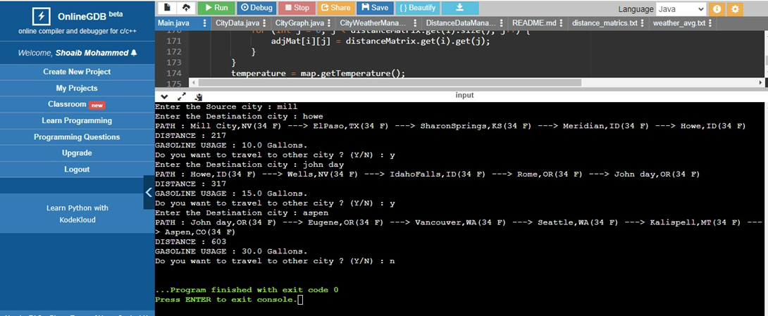
Milestone 1
Visualizing a map showing city names and distances.

Slide 5
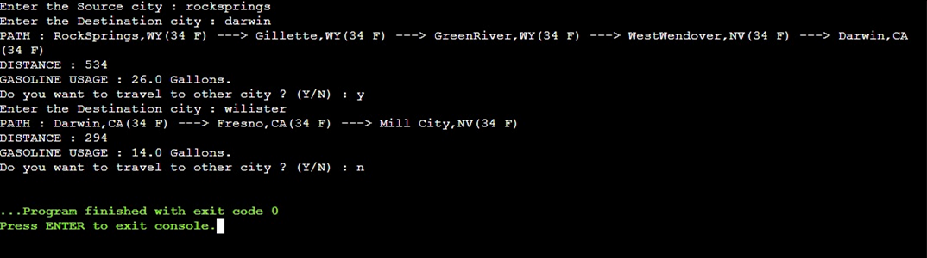
Milestone 1
A program supports find travel maps in any nodes with distances.

Slide 6
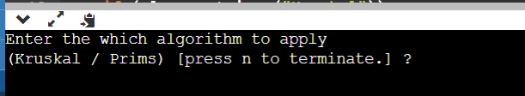
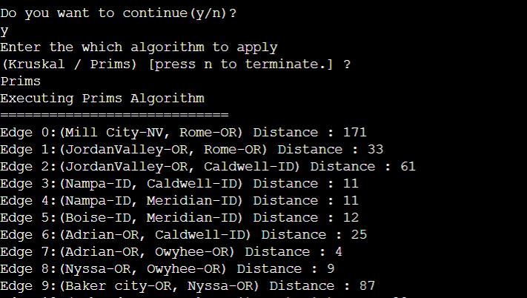
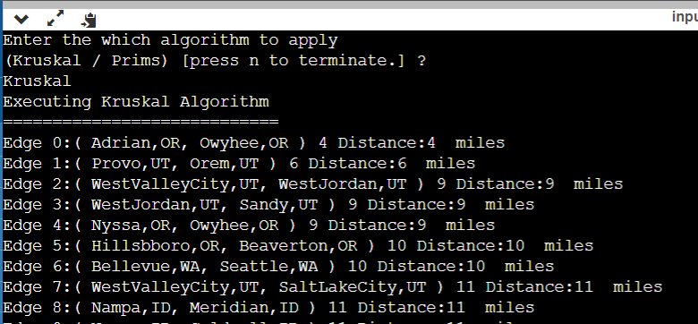
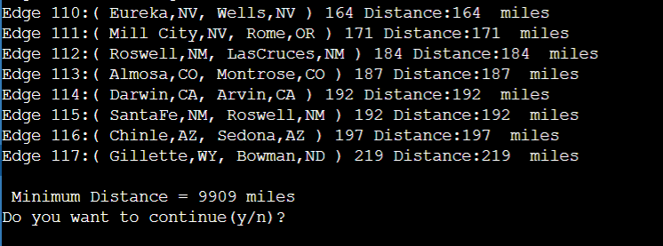
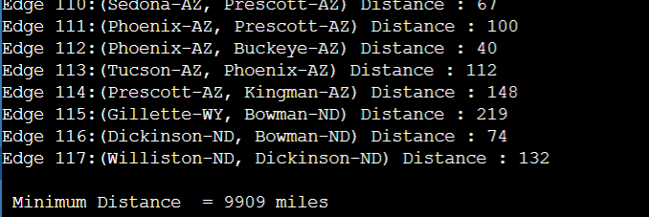
Milestone 2
Run MST algorithm: both Kruskal algorithm and Prim Algorithm (onlinegdb.com).

Slide 7
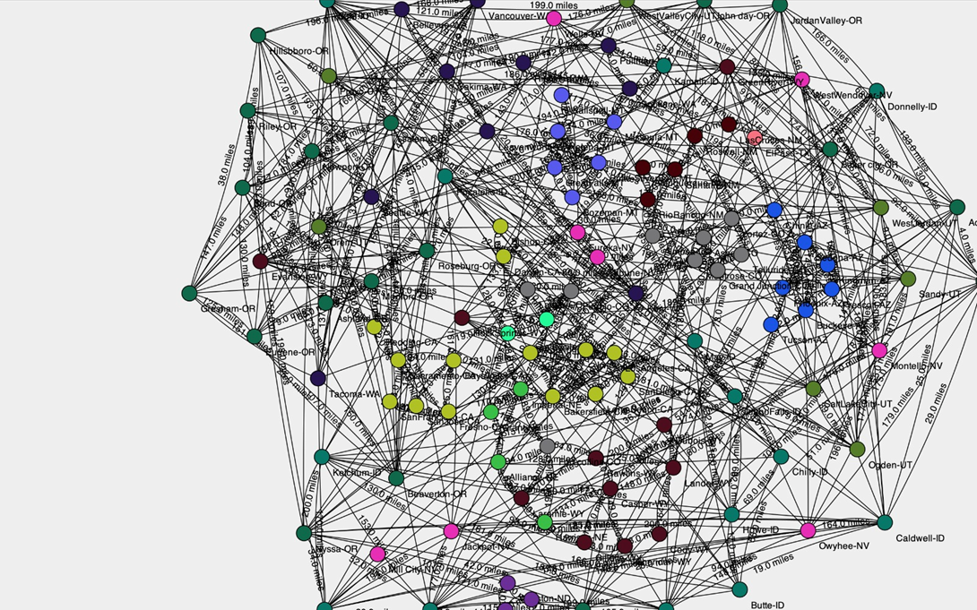
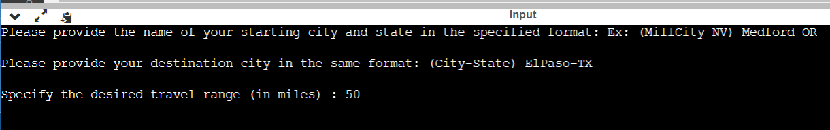
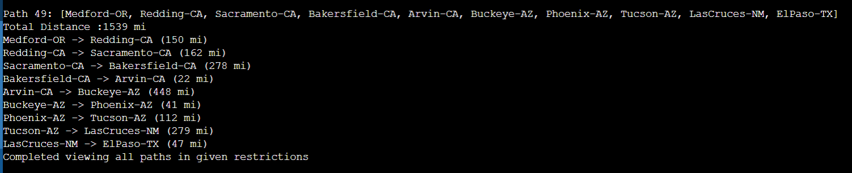
Milestone 2
Visualizing a map showing city names and distances.
A program supports find travel maps in any 10 nodes with distances.

Slide 8
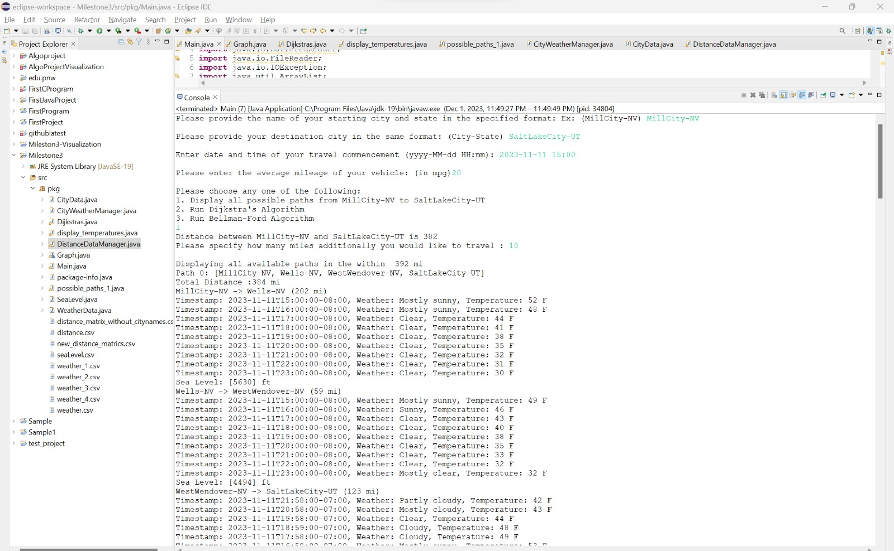
Milestone 3
Run shortest Path algorithms: both Bellman-Ford algorithm and Dijkstra Algorithm (onlinegdb.com)
Fig: Possible paths

Slide 9
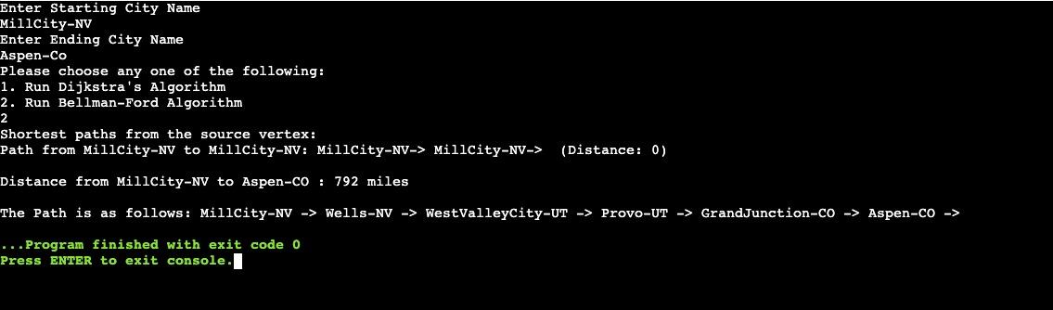
Milestone 3
Run shortest Path algorithms: both Bellman-Ford algorithm and Dijkstra Algorithm (onlinegdb.com)
Fig: BellmanFord Algorithm

Slide 10
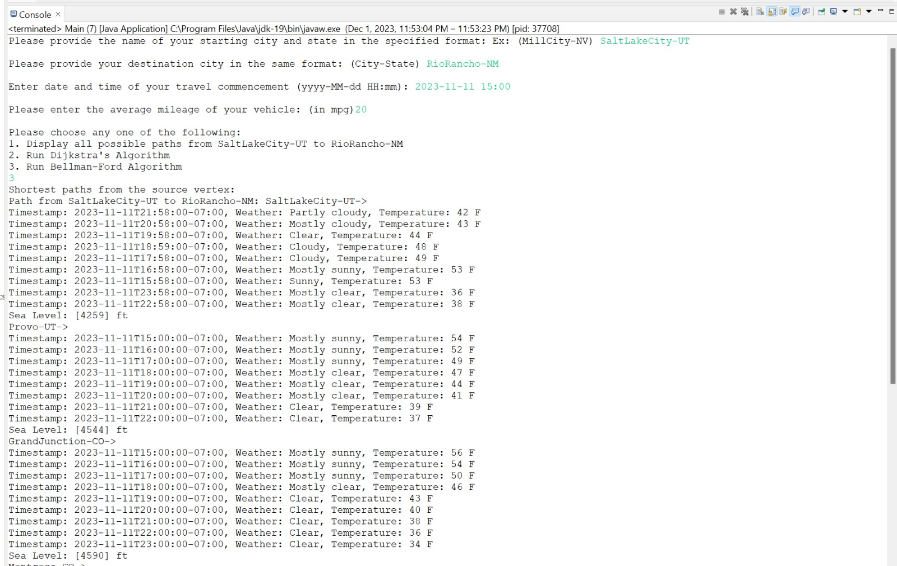
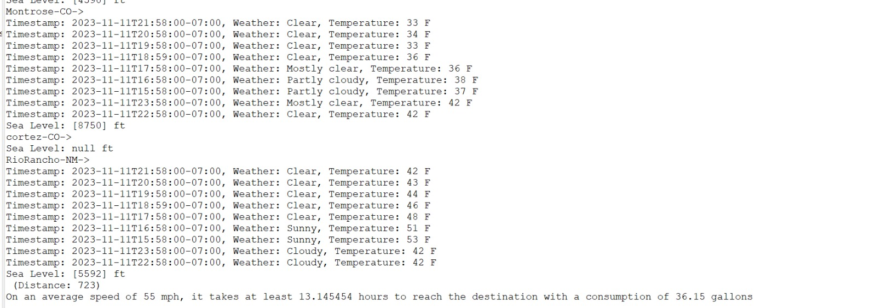
Milestone 3
Run shortest Path algorithms: both Bellman-Ford algorithm and Dijkstra Algorithm (onlinegdb.com)
Fig: BellmanFord Algorithm

Slide 11
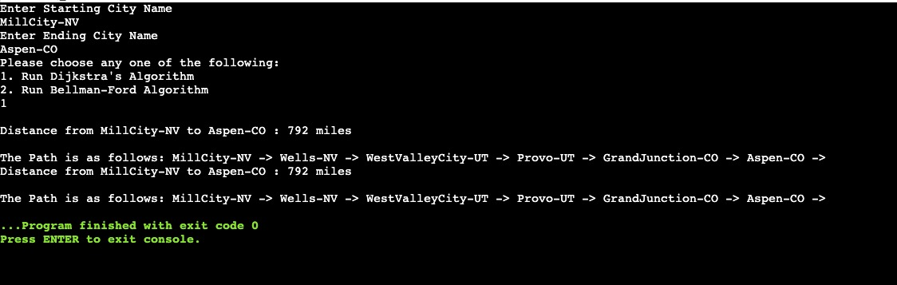
Milestone 3
Run shortest Path algorithms: both Bellman-Ford algorithm and Dijkstra Algorithm (onlinegdb.com)
Fig: Dijkstra Algorithm

Slide 12
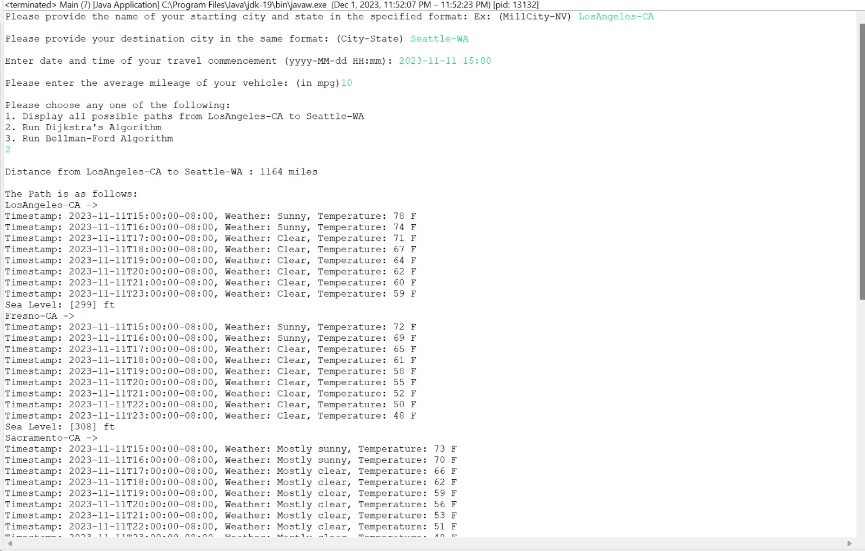
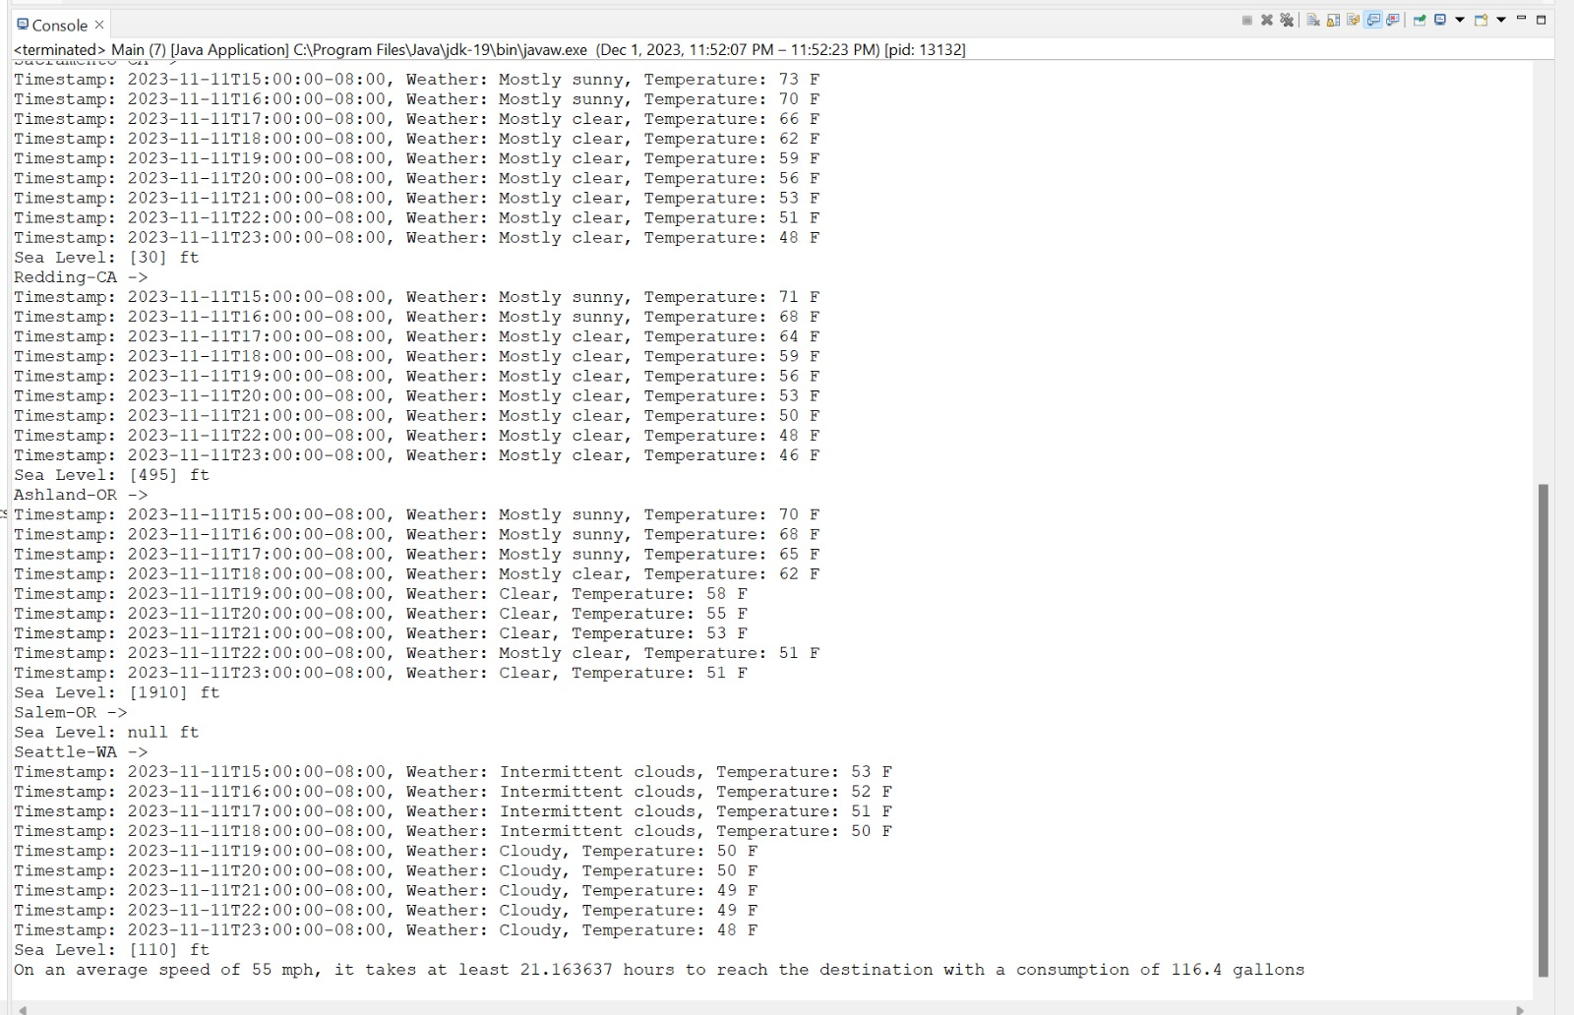
Milestone 3
Run shortest Path algorithms: both Bellman-Ford algorithm and Dijkstra Algorithm (onlinegdb.com)
Fig: Dijkstra Algorithm

Slide 13
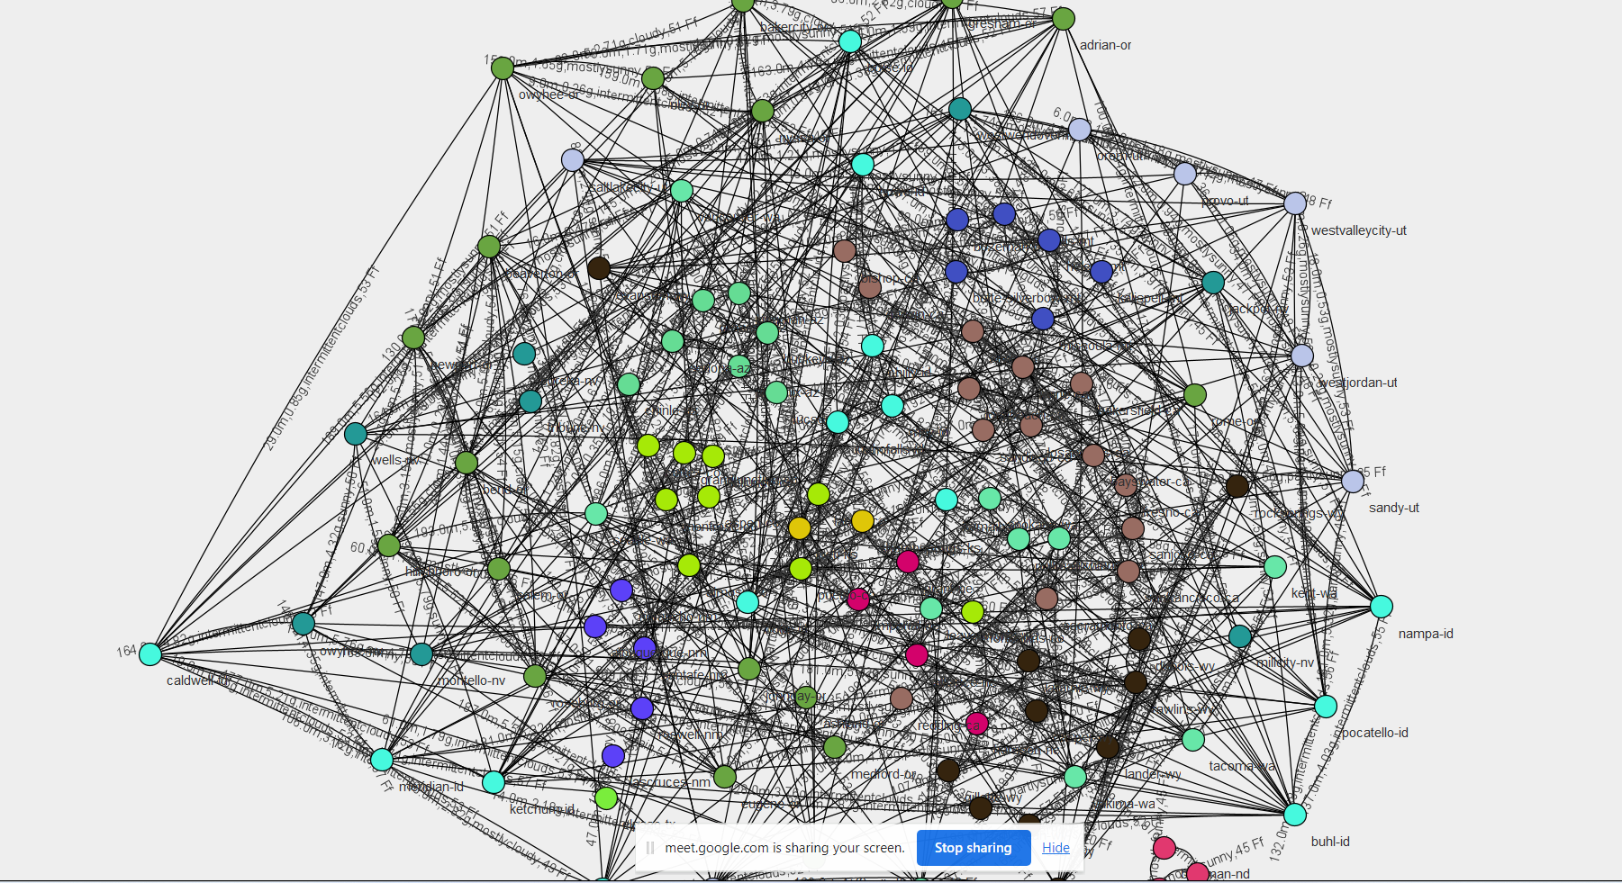
Milestone 3
Visualizing a map showing city names, distances, gas consumption, weather conditions.

Slide 14
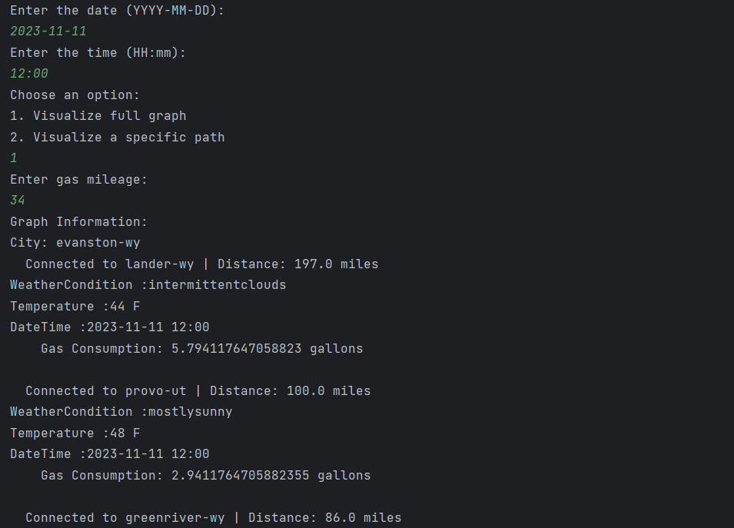
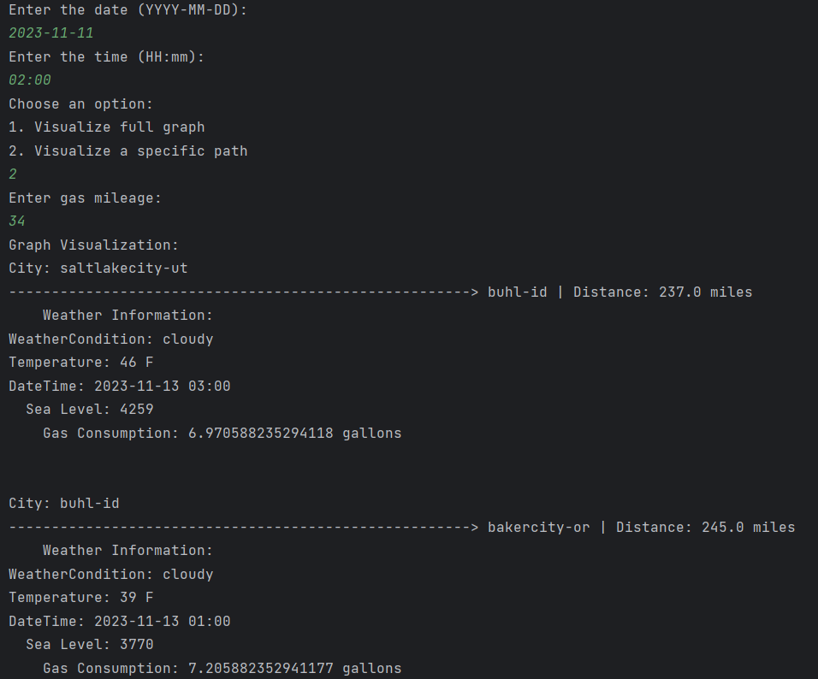
Milestone 3
A program supports find travel maps in any two cites with the shortest path including city names, distances, gas consumption, weather conditions.

Slide 15
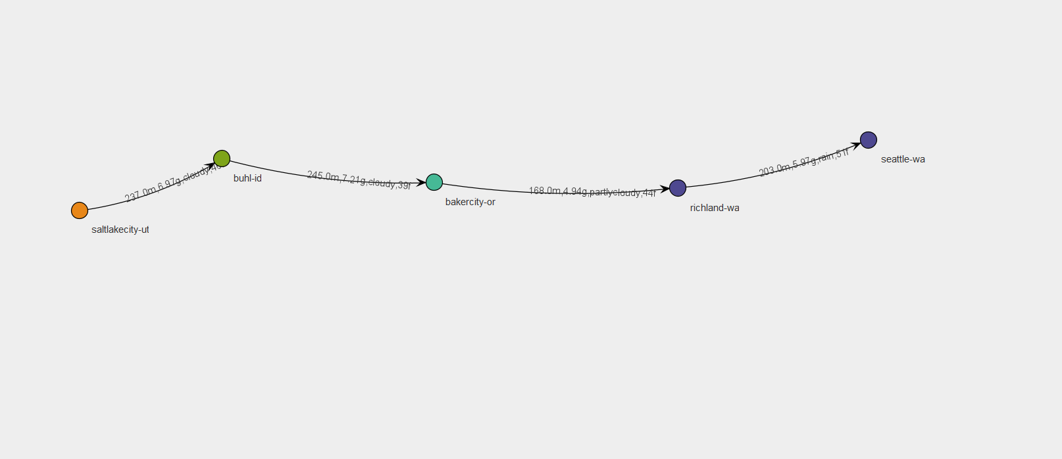
Milestone 3
A program supports find travel maps in any two cites with the shortest path including city names, distances, gas consumption, weather conditions.

